Slide 1
Classifying r/History and r/AlternativeHistory posts
Leonardo Blas

Slide 2

Introduction
I’m interested in classifying social media posts as “legit” or “fake”.
I decided to scrape and classify r/History and r/AlternativeHistory posts.

Slide 3
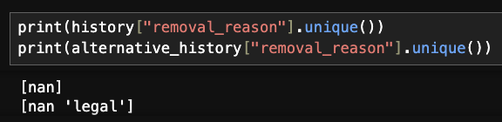
Challenges and opportunities
Different subreddits may have different submission schemes.
Even if two subreddits’ submissions have the same feature, that column’s values can vary a lot.

Slide 4
One approach
Homogenize the features for both types of posts.
Use as many reasonable features as possible to make good predictions.
Mix both categories of posts into a dataset and chuck it into a model.

Slide 5
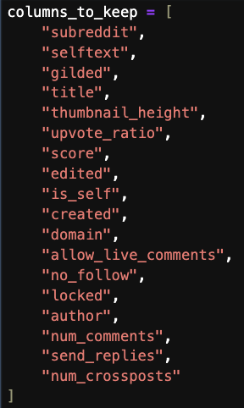
Decisions
Chosen features
Chosen tools
LogisticRegression().
RandomForestClassifier().
Both vanilla because gridsearch was taking a long time.
TfidfVectorizer, because we want each token to have a weight.

Slide 6
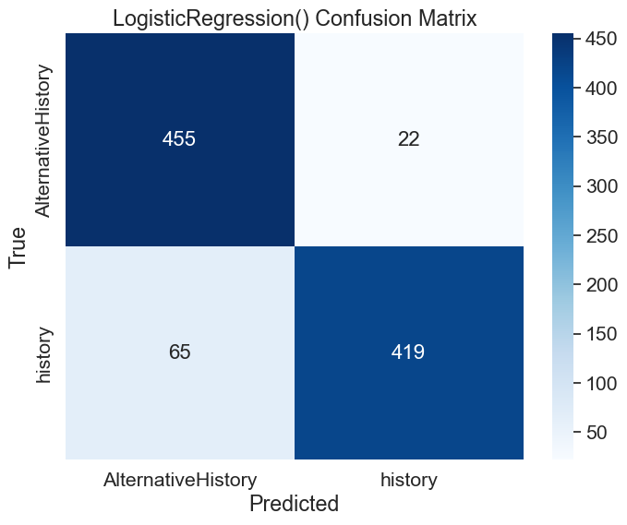
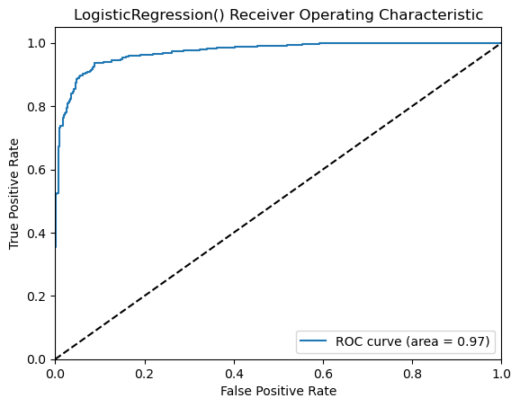
Logistic model

Slide 7
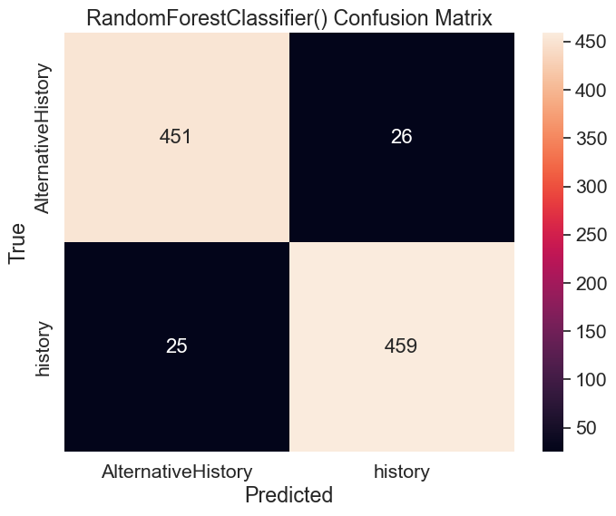
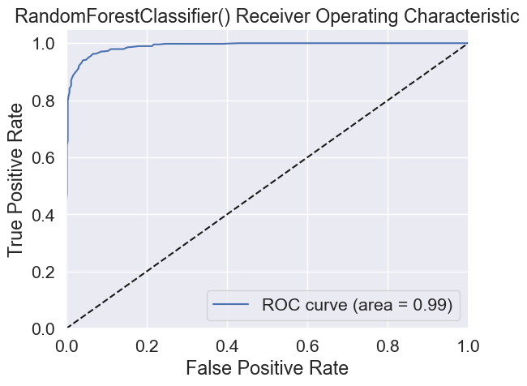
Random forest classifier model

Slide 8
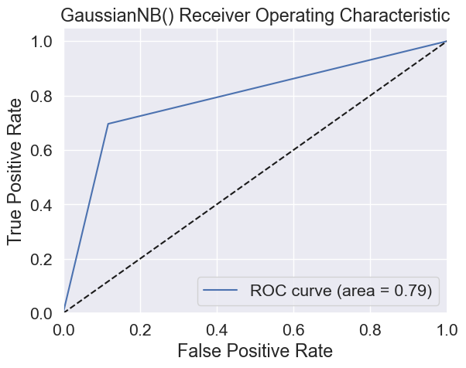
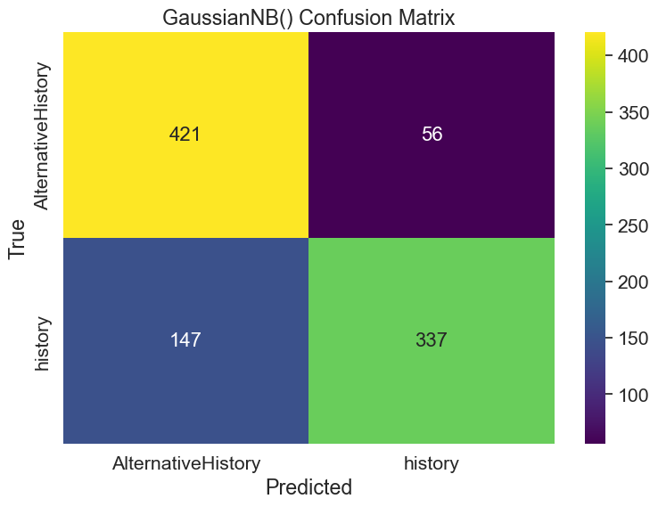
Naïve bayes model

Slide 9
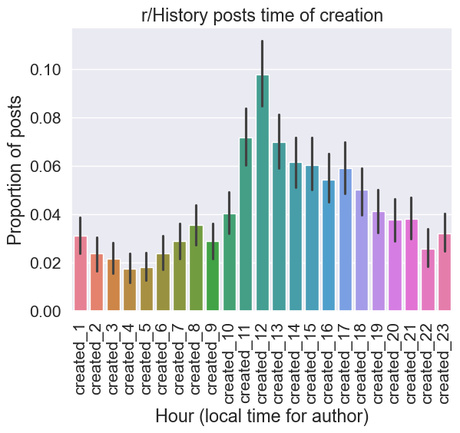
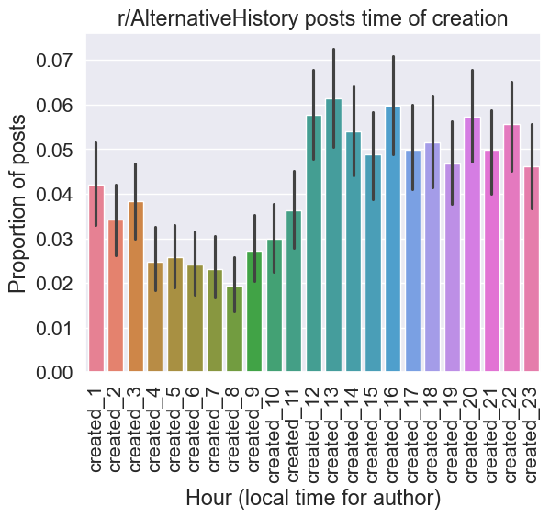
Interesting: Time of posting

Slide 10
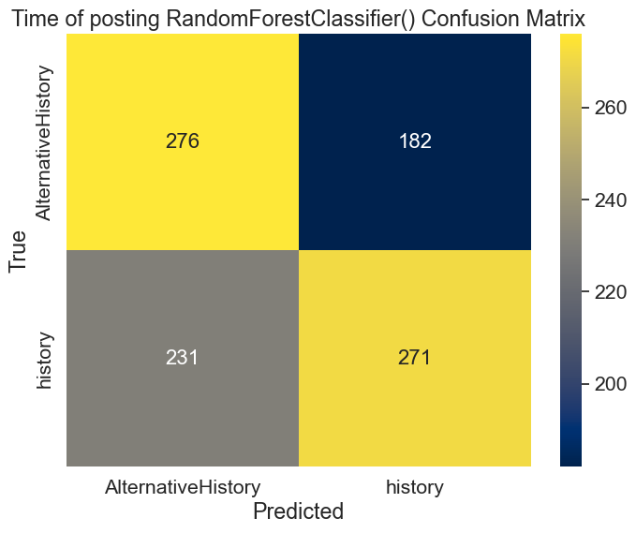
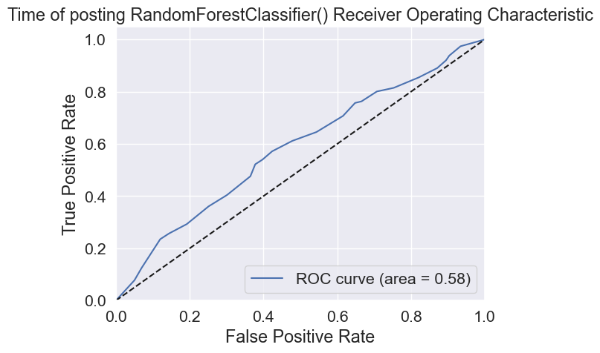
Interesting: Time of posting as predictor

Slide 11
Conclusion
Vanilla classifiers are surprisingly good at classifying posts from closely related topics.
Logistic regressor: ~0.95 train, ~0.90 test.
Random forest classifier: 1.0 train, ~0.95 test.
Posts are more than text. Other features, like the number of crossposts (how many times a post was featured in other unique subreddits) proved to be helpful.
Interesting: The time of posting achieved ~0.56 accuracy in a random forest classifier model.

